Slide 1

Applied Data Science Portfolio
John O’Rourke
NetID: JTOROURK
Email: jtorourk@syr.edu

Slide 2
What is Applied Data Science?
This program encompasses the entire life-cycle of data analysis from data gathering and preparation to complex model development.
The Applied Data Science program allows for students to take practical approaches to problems.
This is done by avoiding “paint-by-numbers” style projects and allowing students to creatively select their project topics.
A wide range of tools are utilized within this program to ensure students can both:
Prepare and analyze complex datasets
Communicate findings clearly

Slide 3
Which courses will be covered?
IST 644 – Natural Language Processing
IST 707 – Applied Machine Learning
IST 718 – Big Data Analytics
IST 769 – Advanced Big Data Management

Slide 4
Program Learning Goals
The MS in Applied Data Science program holds certain key learning goals/objectives in high regard. Those goals/objectives are as follows:
Collect, store, and access data by identifying and leveraging applicable technologies.
Create actionable insight across a range of contexts (e.g., societal, business, political), using data and the full data science life cycle.
Apply visualization and predictive models to help generate actionable insight.
Use programming languages such as R and Python to support the generation of actionable insight.
Communicate insights gained via visualization and analytics to a broad range of audiences (including project sponsors and technical team leads).
Apply ethics in the development, use and evaluation of data and predictive models (e.g., fairness, bias, transparency, privacy).

Slide 5
IST 664:
Natural Language Processing

Slide 6
Email Spam Classification
This project focuses on spam detection within emails using machine learning algorithms.
The goal of the project is to determine the likelihood of an email being spam based on its sentiment, utilizing the Naïve Bayes algorithm and the VADER sentiment lexicon.
The analysis utilizes the Enron Spam dataset, consisting of 1,500 spam files and 3,672 "ham" files, to train the models.
Three models were developed, allowing for experimentation with different lexicon and vectorizer combinations.
The project aims to find the best-fit model for accurate spam detection within the dataset.

Slide 7
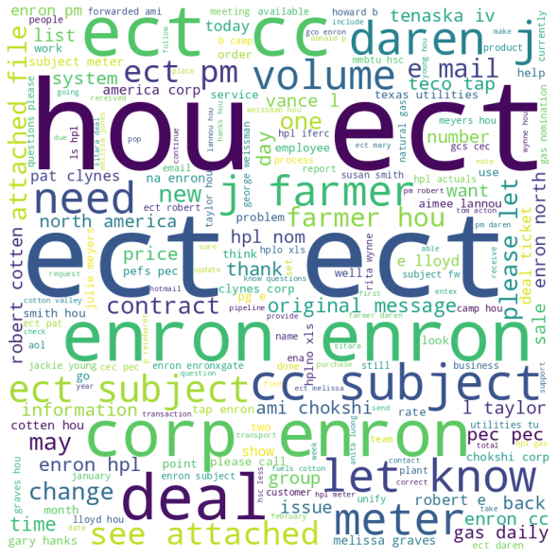
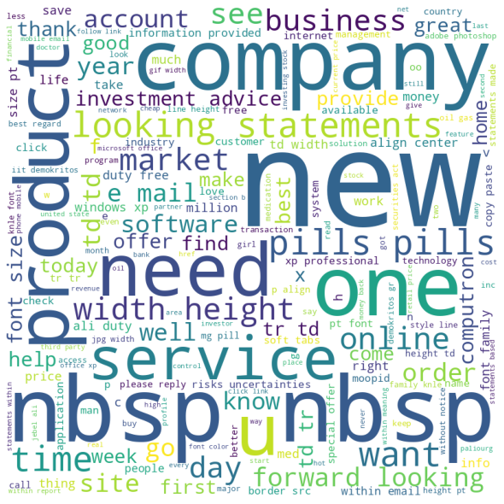
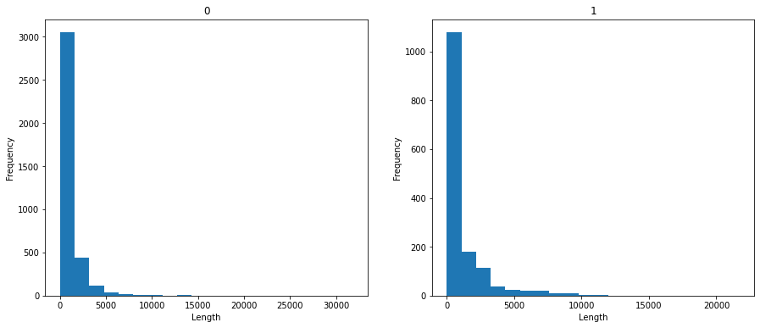
Exploratory data analysis
“ham” emails
“spam” emails

Slide 8
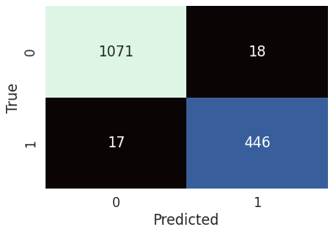
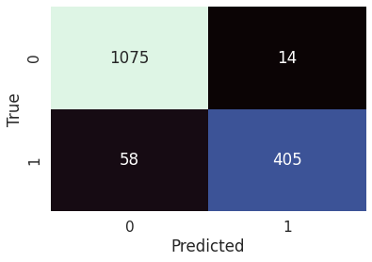

Project Results
Naïve Bayes
Naïve Bayes + VADER
Naïve Bayes + VADER + TF-IDF

Slide 9
Learning Goals and Outcomes
Successfully collected, stored, and accessed data using Python and the Enron Email dataset.
Applied visualization and predictive models, including Naive Bayes and VADER sentiment analysis, to generate actionable insights for spam detection in emails.
Utilized Python and associated libraries for efficient analysis and transformation of text data.
Communicated insights through visualization techniques such as Word Clouds and Confusion Matrices.
Ensured ethical practices throughout the project, avoiding bias by employing fair and transparent model development and analysis.

Slide 10
IST 707: Applied Machine Learning

Slide 11
Song Popularity Predictions
This project aimed to create a predictive model utilizing Naïve Bayes, Decision Trees, and Support Vector Machines (SVM) to determine the popularity of a song based on its characteristics.
The data, sourced from Kaggle using the Spotify Web API, included scores for different categories/attributes of songs.
Pre-processing revealed that attributes such as "danceability," "loudness," "duration (in ms)," "energy," and "key" had the most impact on model performance.
The dataset consisted of the top 2000 songs on Spotify from 2000 to 2019.
R programming language was utilized throughout the project, achieving a 54.06% accuracy with Naïve Bayes.
Future improvements could involve association rule mining to better understand the attributes' correlation and determine the best attributes for model performance.

Slide 12
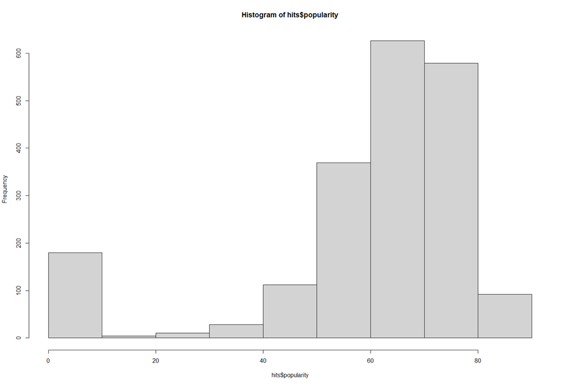
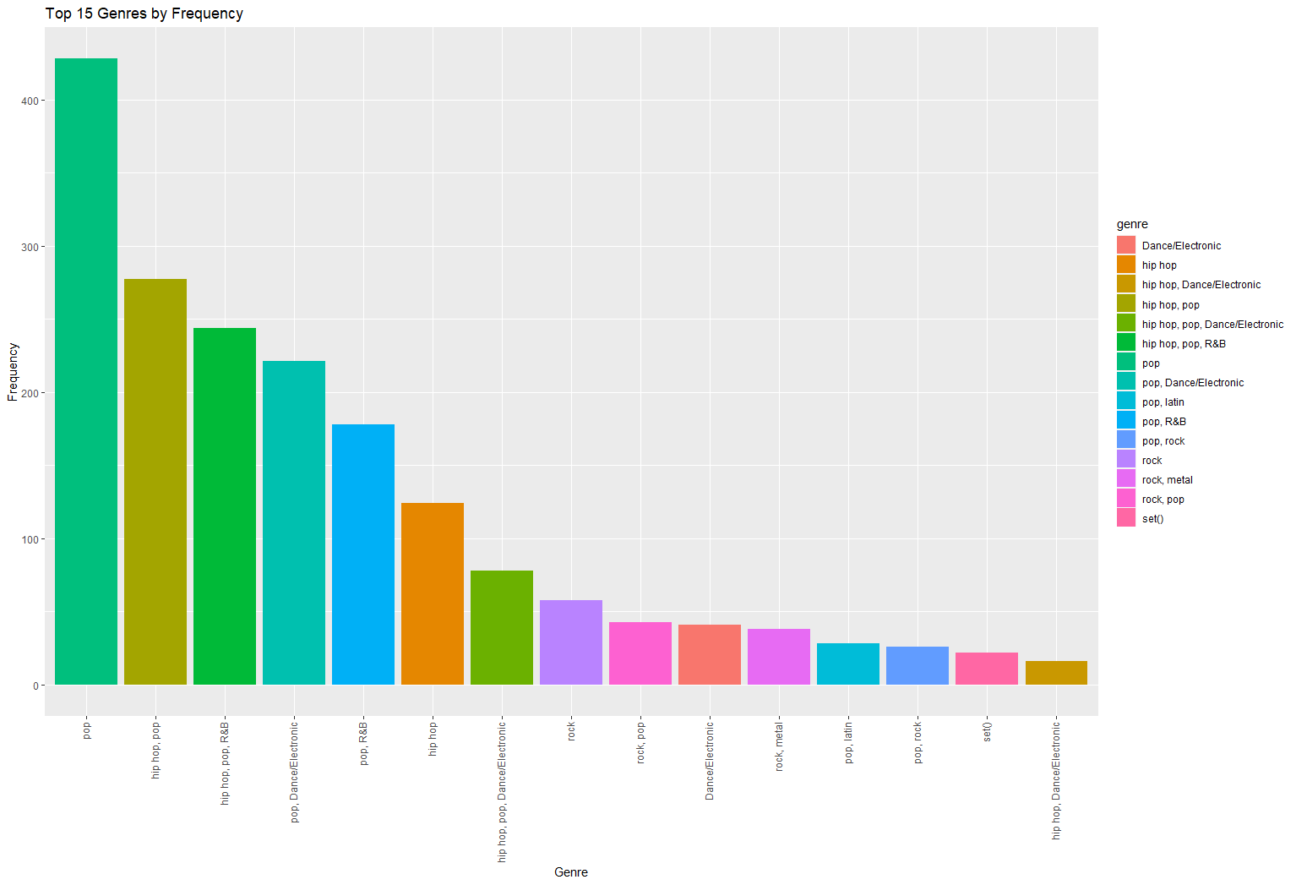
Exploratory Data Analysis

Slide 13
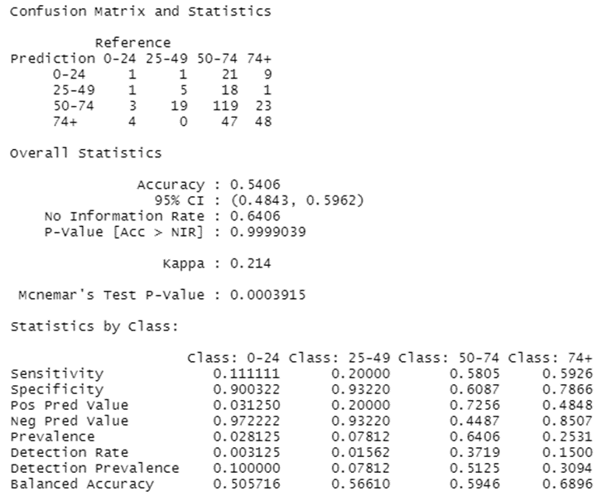
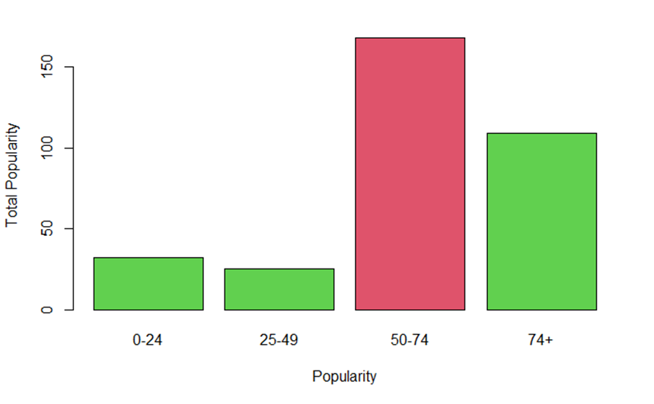
Project Results

Slide 14
Learning Goals and Outcomes
Successfully collected, stored, and accessed data using R and Kaggle repositories.
Applied descriptive analytics and visualizations, showcasing insights and model results through bar plots with the "ggplot" package.
Implemented ethical practices by running analyses on random samples and obscuring the goal value (popularity) to ensure fair development, use, and evaluation of the data.

Slide 15
IST 718: Big Data Analytics

Slide 16
Drought Prediction within the Continental US
This project focuses on early drought detection in the United States to enable proactive measures and aid in combating severe droughts.
The goal was to develop a forecasting model that effectively predicts the occurrence and severity of droughts based on weather and soil conditions.
Historical data collected from "Predict droughts using weather & soil data" is utilized for model development.
Random forest and decision tree modeling techniques are employed for regression and classification, enhancing understanding and predicting values.
SARIMAX predictive model was selected for geo mapping and outputting predictions.
The project provides accurate representations of potential drought locations and their severity through modeling techniques and visualizations.

Slide 17
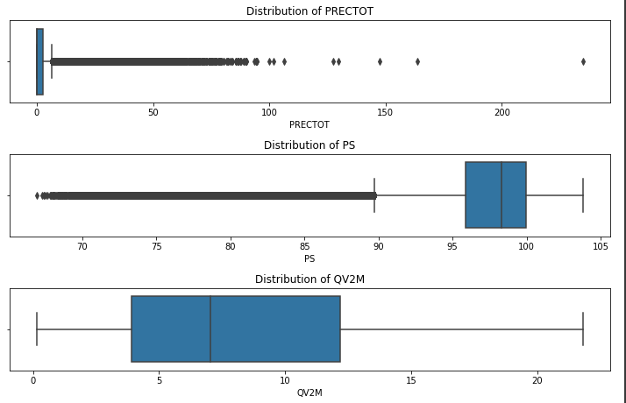
Exploratory Data Analysis

Slide 18
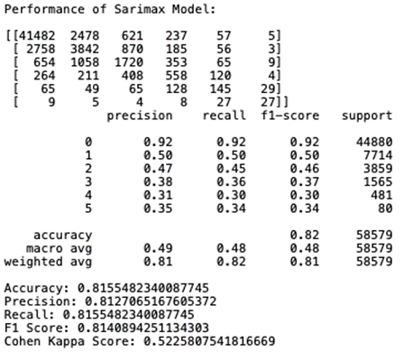
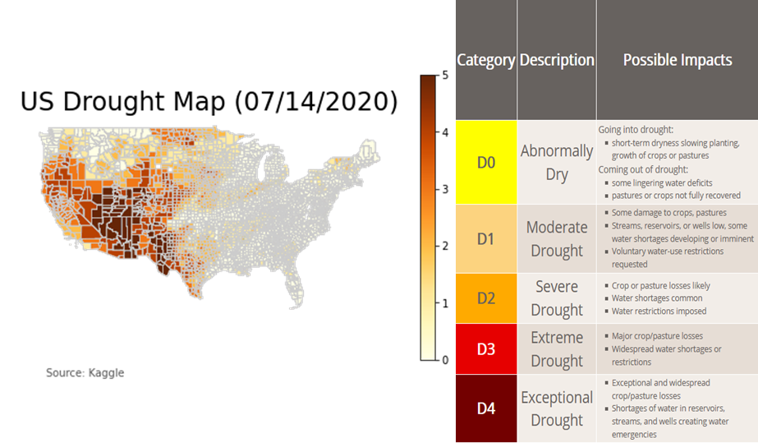
Project Results

Slide 19
Learning Goals and Outcomes
Applied analysis and project development that fulfilled all 6 Program Learning Goals.
Generated actionable insights across multiple contexts, benefiting large businesses, government entities, and individual citizens.
Communicated insights effectively to all parties involved.
Achieved models with accuracy within acceptable thresholds, enabling proactive measures and drought prevention methods.

Slide 20
IST 769: Advanced Big Data Management

Slide 21
Why this course?
This course was heavily focused on ensuring that a student could effectively utilize a wide-variety of database paradigms.
Heavily focused on usage of Docker and containerized applications.
Increased knowledge in tooling that students/professionals would not otherwise have access too.

Slide 22
Spotify Playlist Generation
The project focused on managing and utilizing data for an application or analysis.
The key objective was to ingest song and category data using the Spotify Web API and store it in MongoDB.
A playlist generator was developed, allowing users to customize their playlists based on selected categories and desired number of songs.
While the emphasis of the course was on tooling rather than analysis, no significant transformations were performed on the dataset.
Future improvements could include adding a data analysis component, utilizing top categories data from the Spotify Web API.

Slide 23
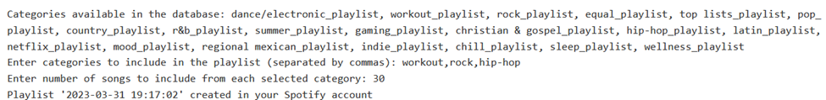
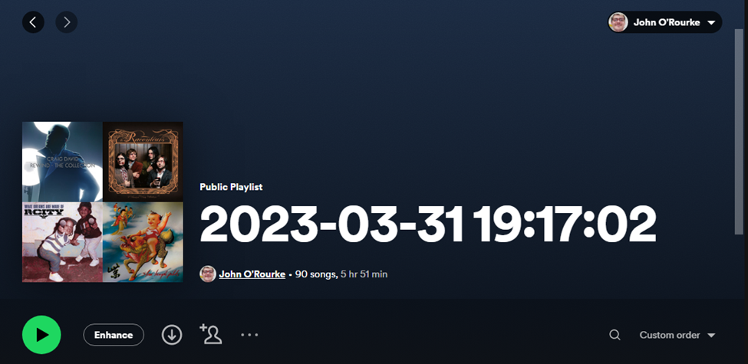
Project Results
User Input
Generated Playlist

Slide 24
Learning Goals and Outcomes
Demonstrated proficiency in collecting, storing, and accessing data.
Identified and utilized the best technologies and database paradigm for data management.
Developed skills in using Python, along with its libraries and tooling, for application development.

Slide 25
Final Thoughts

Slide 26
Conclusion
Each of the 4 courses discussed in this document played a significant role in enhancing my understanding of applying various analysis and modeling techniques and effectively showcasing the gathered insights.
While some projects may not have direct business applications, the techniques employed can be adapted and applied to different industries, enabling the development of new and valuable insights regardless of the dataset.

Slide 27
References
Androutsopoulos, I. (n.d.). The Enron-spam datasets. Retrieved March 21, 2023, from https://www2.aueb.gr/users/ion/data/enron-spam/
Koverha, M. (2022, May 31). Top hits spotify from 2000-2019. Kaggle. Retrieved July 12, 2022, from https://www.kaggle.com/datasets/paradisejoy/top-hits-spotify-from-20002019
Metsis, V., Paliouras, G., & Androutsopoulos, I. (n.d.). Athens University of Economics and Business. Retrieved March 21, 2023, from https://www2.aueb.gr/users/ion/docs/ceas2006_paper.pdf
Minixhofer, C. (2021, March 3). Predict droughts using weather & soil data. Kaggle. Retrieved September 21, 2022, from https://www.kaggle.com/datasets/cdminix/us-drought-meteorological-data
Pang, B., Lee, L., & Vaithyanathan, S. (n.d.). Thumbs up? sentiment classification using Machine Learning Techniques. ACL Anthology. Retrieved March 21, 2023, from https://aclanthology.org/W02-1011/
Resources and dataset descriptions. Resources and Dataset Descriptions - VaderSentiment 3.3.1 documentation. (n.d.). Retrieved March 21, 2023, from https://vadersentiment.readthedocs.io/en/latest/pages/resource_description.html

Slide 28
Thank you for an amazing experience!

